Slide 1
Testing
Microphone , Electret mics
Repairing of speaker

Slide 2
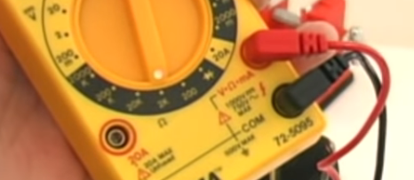

Slide 3
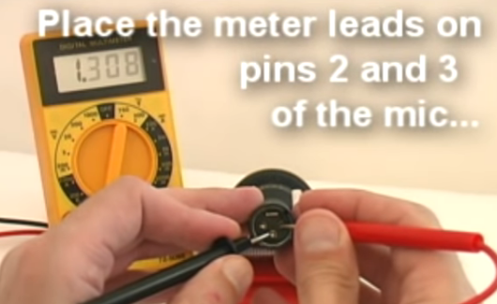
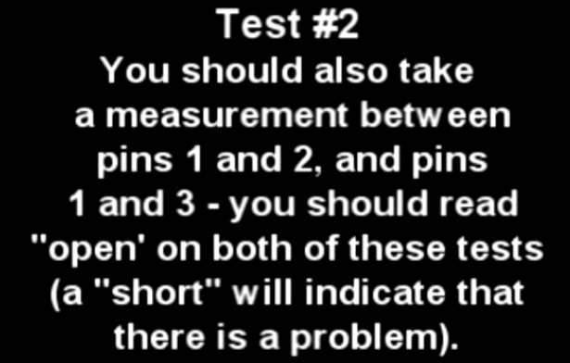

Slide 4
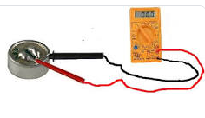
One probe goes onto one microphone terminal and the other probe goes onto the other microphone terminal.
*** set to continuity function
One side reading check ----
It 1000 to 1500 ohms means mic ok
Another side reading is 1
High

Slide 5
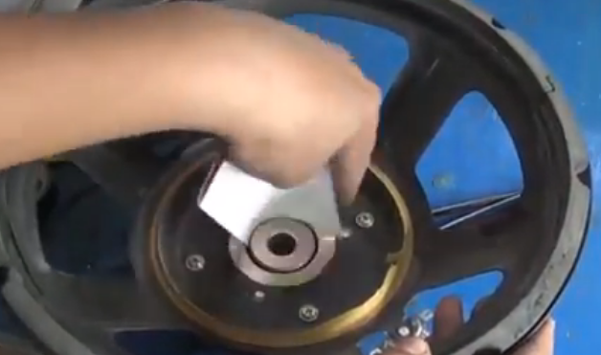
Speaker repairing
1.Clean air gap between magnet & voice coil
Using photo paper.

Slide 6
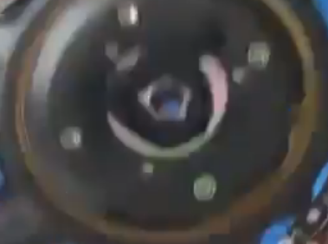
2.Gap is close using tape.
3. Clean spider and cone location with cutter.

Slide 7
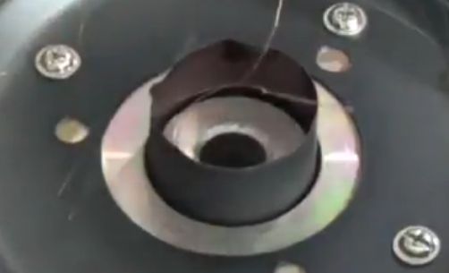
4. Put voice coil on clean gap.

Slide 8
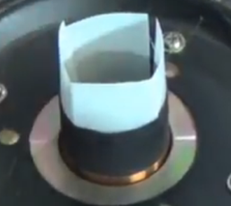
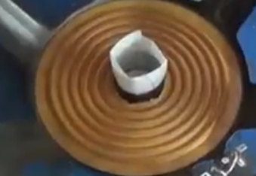
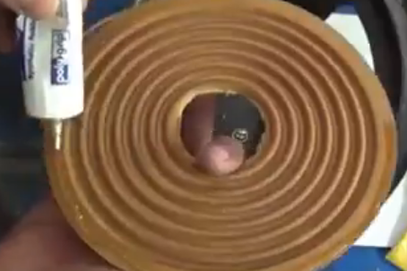
5.Put 4 film cut pies
In air gap .
Half cm coil show.
Coil set with connection terminal

Slide 9
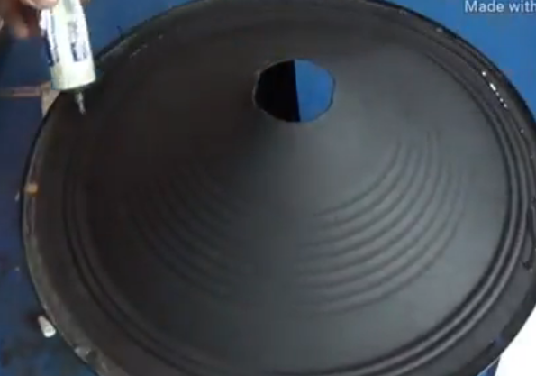
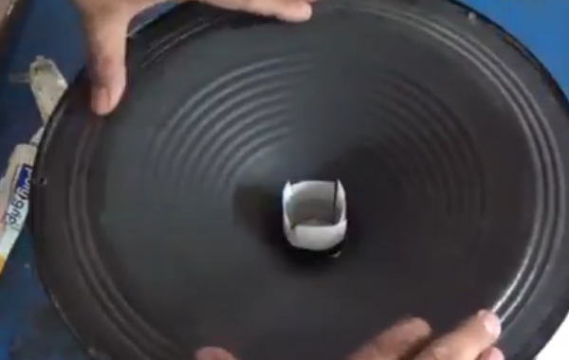
5.Cone fixing
Outer rubber fixing.
½ hr wait .

Slide 10
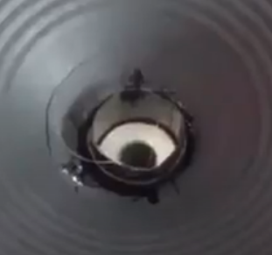
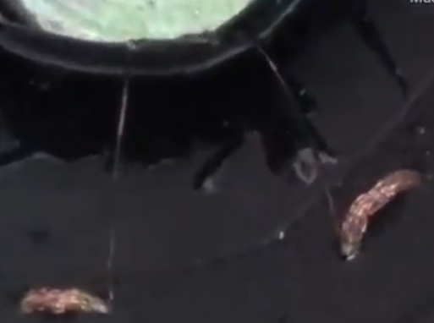
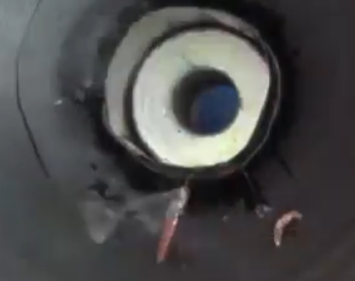
Remove 4 cut paper after ½ hr.
Check coil wire.
Make connection with coil and terminal

Slide 11
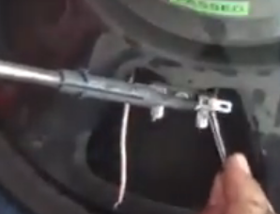
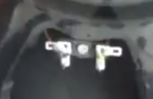
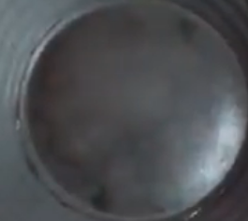
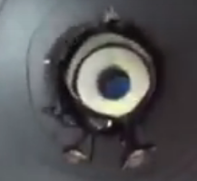
Connection check using M.M (continuity check)
Put dust cap
Put glue on wire.

Slide 12
Ok
SO what U required …

